Slide 1

SQL PROJECT
INDIA GENERAL ELECTION ANALYSIS
2024

Slide 2
Project Overview
This project performs an SQL-based analysis of the India General Election Results 2024 to study constituency-wise, state-wise, and party-wise performance. Using structured queries and relational database techniques, the project identifies voting trends, winning margins, and seat distribution. The analysis highlights the practical application of SQL in handling real-world datasets and generating meaningful insights for data-driven decision making.

Slide 3
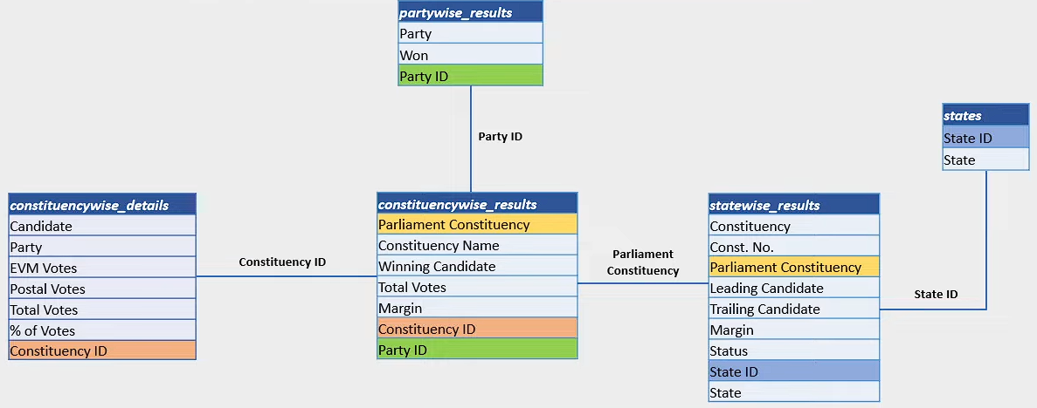
ER – DIAGRAM

Slide 4
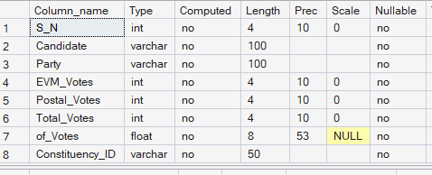
TABLE STRUCTURE
1. constituencywise_details
This table stores constituency-level election results including Constituency name, winning candidate, total votes, margin and associated party ID. It helps analyze constituency-wise performance.

Slide 5
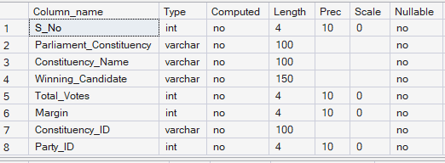
TABLE STRUCTURE
2. constituencywise_results
The constituencywise_results table captures final election results at the constituency level. It includes constituency name, winning candidate, total votes, enabling constituency –level performance analysis.

Slide 6


TABLE STRUCTURE
3. partywise_results
The partywise_results table stores political party-level election outcomes . It contains party name, total seats won, and party ID which helps analyze overall party performance in th election.

Slide 7


TABLE STRUCTURE
4. states
The state table acts as a master reference table storing state IDs and state names. It is used to link and organize election data across different states efficiently.

Slide 8

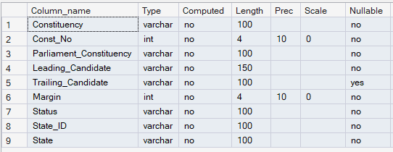
TABLE STRUCTURE
4. stateswise_results
The statewise_results table contains state-level election information mapped to parliamentary constituencies. It includes leading and trailing candidates, election status, margin, and state ID, helping analyze state-wise election trends.

Slide 9
Analytical considerations
1. The dataset accurately represents official constituency-wise, state-wise, and party-wise election results for analysis purposes.
2. Total votes are considered as the sum of all valid votes cast within a constituency.
3. Winning candidates are uniquely identified per constituency.
4. Party-wise results reflect finalized seat outcomes.
5. Vote percentages and margins are reliable indicators of electoral competitiveness.
6. State-wise aggregation assumes correct mapping between constituencies and states.

Slide 10
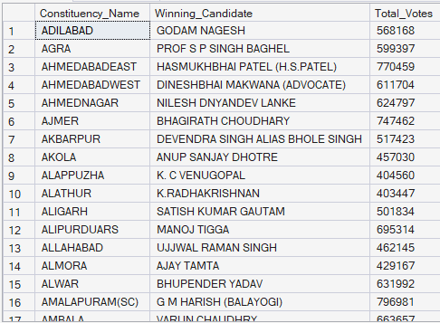
Foundational Data Exploration
Retrieve constituency name, winning candidate, and total votes for all constituencies.
Key Observation:
This query provides a complete overview of constituency-level election outcomes, forming the foundation for further analysis.

Slide 11

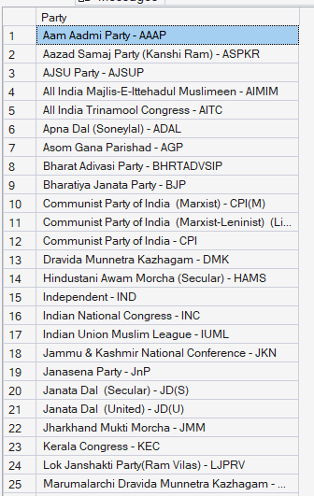
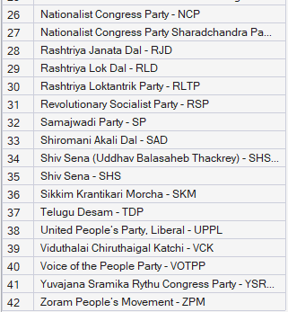
Foundational Data Exploration
List all unique political parties that contested the election.
Key Observation:
This query identifies the total number of political parties participating in the election, helping assess political diversity.

Slide 12

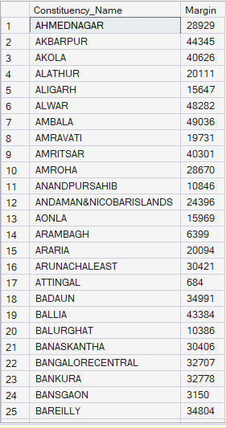
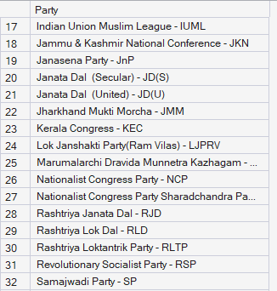
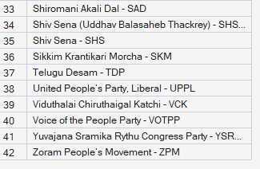
Foundational Data Exploration
Constituencies with margin < 50,000
Key Observation:
This highlights closely contested constituencies where electoral competition was intense.

Slide 13

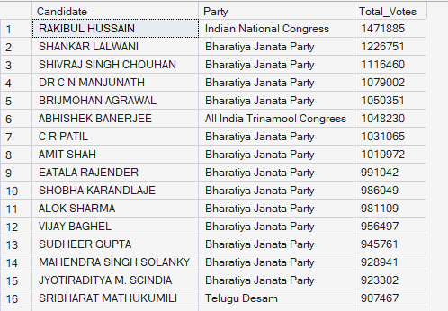
Foundational Data Exploration
Candidates with total votes (descending)
Key Observation:
This reveals top-performing candidates based on vote count, regardless of constituency size.

Slide 14

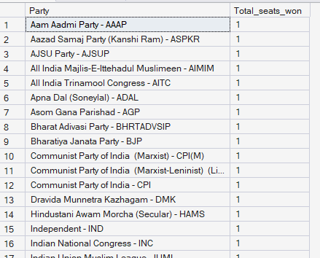
Performance Measurement
Total seats won by each party
Key Observation:
This query identifies the total number of political parties participating in the election, helping assess political diversity.

Slide 15

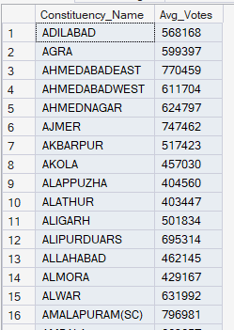
Performance Measurement
Average votes per constituency
Key Observation:
This helps understand typical voter participation levels across constituencies.

Slide 16

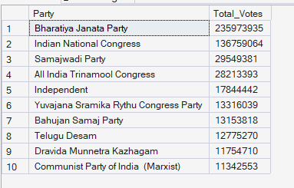
Performance Measurement
Top 10 parties by total votes
Key Observation:
This identifies parties with the strongest voter support across all constituencies

Slide 17

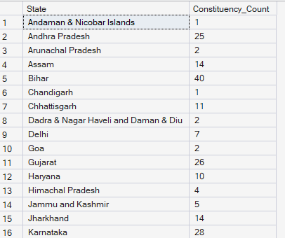
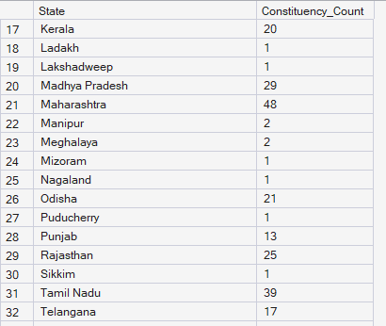

Performance Measurement
Constituency count per state
Key Observation:
This provides a structural view of electoral distribution across states.

Slide 18

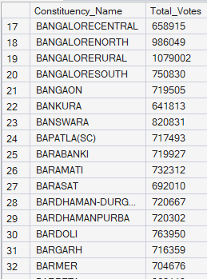
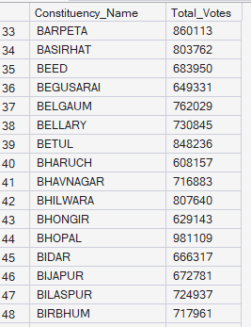
Comparative & Conditional Analysis
Constituencies above average votes
Key Observation:
This highlights high-engagement constituencies with above-average voter turnout.

Slide 19
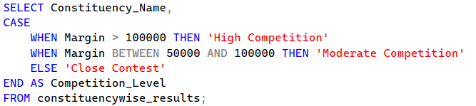
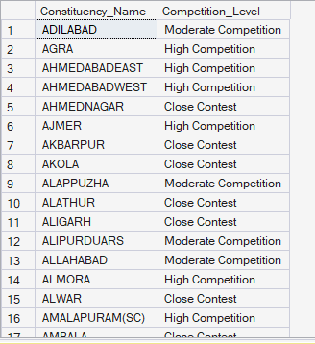
Comparative & Conditional Analysis
Constituency competition classification
Key Observation:
This categorizes constituencies based on winning margins to assess electoral competitiveness.

Slide 20
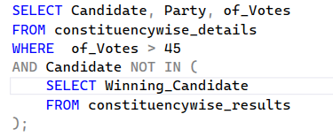
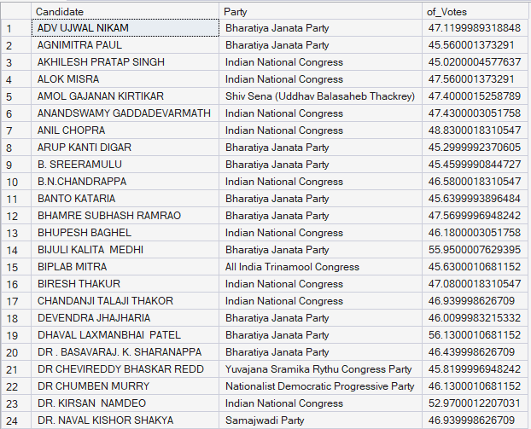
Comparative & Conditional Analysis
High vote share candidates who lost
Key Observation:
This identifies strong candidates who narrowly lost despite significant voter support.

Slide 21
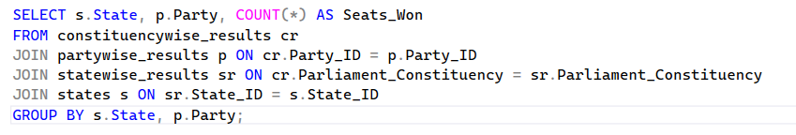
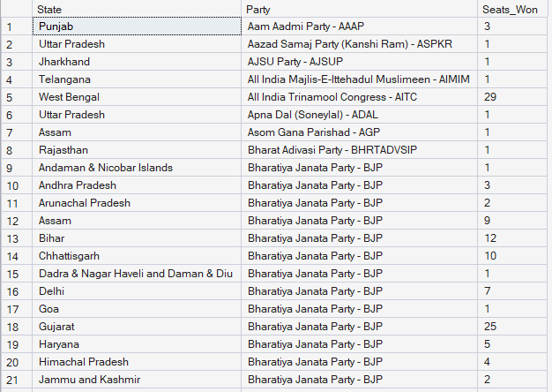
Multi-Dimensional Election Insights
State-wise seats won by each party
Key Observation:
This shows party-wise dominance and competition at the state level.

Slide 22
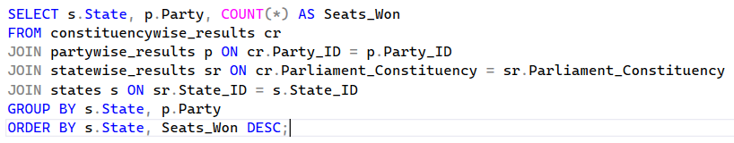
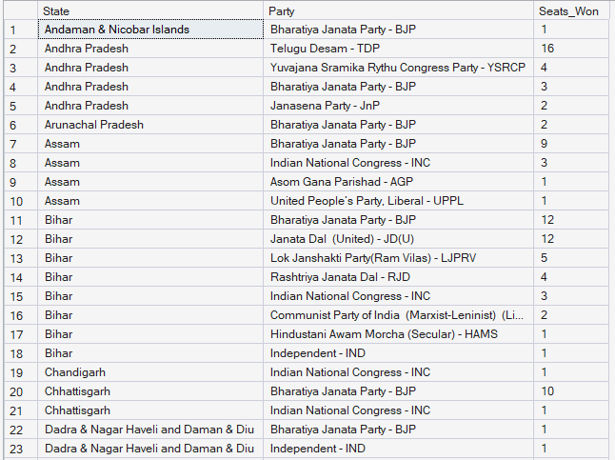
Multi-Dimensional Election Insights
Leading party per state
Key Observation:This determines the most influential political party in each state based on seat count.

Slide 23
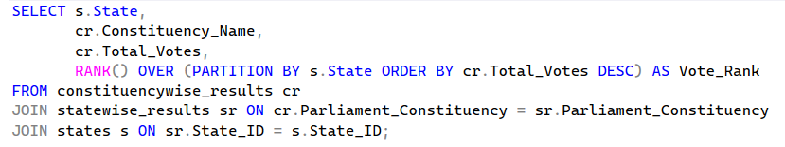
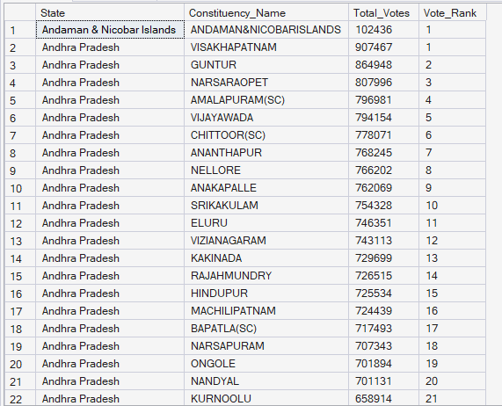
Multi-Dimensional Election Insights
Ranking constituencies by votes within state
Key Observation:
This ranks constituencies by voter turnout, enabling intra-state comparison using window functions.

Slide 24
Conclusion:
. The analysis provides a comprehensive view of election outcomes at constituency, party, and state levels using structured SQL queries.
. Party-wise and state-wise aggregations highlight overall political dominance and regional performance patterns.
. Margin-based and average-vote comparisons reveal the level of electoral competitiveness across constituencies.
. Identification of high-vote-share losing candidates uncovers closely contested elections and strong opposition presence.
. Ranking and multi-dimensional queries demonstrate effective use of SQL for real-world analytical insights and decision support.

